Slide 1
Lecture 8 More for loops! Analysis example: Resampling inference
Kristin Privitera-Johnson
FISH 553 Advanced R
School of Aquatic and Fishery Sciences
University of Washington

Slide 2
Background / further readings
Textbook: Manly BJF 2006 Randomization, bootstrap and Monte Carlo methods in biology, 3rd Edition, Chapman & Hall/CRC $115
If this lecture material interests you, take STAT 403

Slide 3
Why use resampling?
Standard statistical tests assume that data are collected in a way that matches a particular statistical distribution
Very often data are complex, estimators are complicated, and standard formulae simply don’t apply
Resampling can be used on any kind of data, and any kind of estimator, to test any hypothesis

Slide 4
Resampling statistics
Definition: randomly recycling the scores that make up your data set, to answer statistical questions
Applications include the following:
Estimating the precision of statistics using jackknifing (excluding parts of data) or bootstrapping (drawing randomly with replacement)
Permutation tests that use resampling to test for significance
Validating methods using random subsets of data (cross-validation)

Slide 5
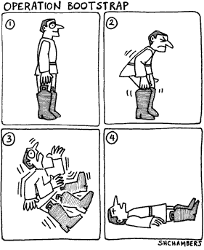
Bootstrapping
A self-sustaining process that proceeds without external help
“pull oneself over a fence by ones bootstraps”, i.e. an absurdly impossible action
Also the origin of “booting” software
Stats: obtain results using only the data you collected
Cartoon: Scott Chambers http://www.mouthmag.com/issues/58/number58.htm

Slide 6
Bootstrapping
Data X₁, X₂, ..., X_{n}, computing a statistic θ
Randomly draw n values from the data with replacement (same value can be drawn multiple times), calculate θ₁
Repeat a large number of times to obtain the distribution: θ₁,θ₂, ..., θ_{n}
The resulting distribution is the bootstrap sampling distribution
Compute standard deviation and 95% confidence intervals from this

Slide 7
Problem: which journal should I choose?
Two prominent fisheries journals are the Canadian Journal of Fisheries and Aquatic Sciences (CJFAS) and the ICES Journal of Marine Sciences (ICES)
Data: number of citations to each article published during 2008-2012 ("CJFAS.csv", "ICES.csv")
Statistic | ICES | CJFAS
Citations per article | 6.78 | 7.05
Number of articles | 1093 | 955
Fraction with zero cites | 0.106 | 0.114
Most cites for one article | 391 | 59

Slide 8
Bootstrapping variability
For a sampling distribution of citations per article
mean.boot <- function(cites, niter) {
bmean <- vector(length=niter)
for (i in 1:niter) {
newsamp <- sample(x=cites,
size=length(cites),replace=T)
bmean[i] <- mean(newsamp)
}
cat(mean(bmean), "\n")
cat(quantile(bmean, c(0.025, 0.975)), "\n")
invisible(bmean)
}
ICES <- read.csv("Data\\ICES.csv")
x <- mean.boot(cites=ICES$Citations, niter=1000)
Sample with replacement n items from a vector with n items
Calculate mean of each sample and store in bmean
Calculate lower and upper 95% of bootstrap distribution

Slide 9
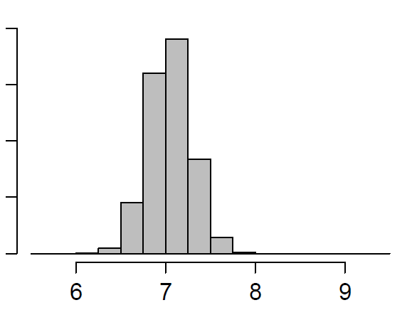
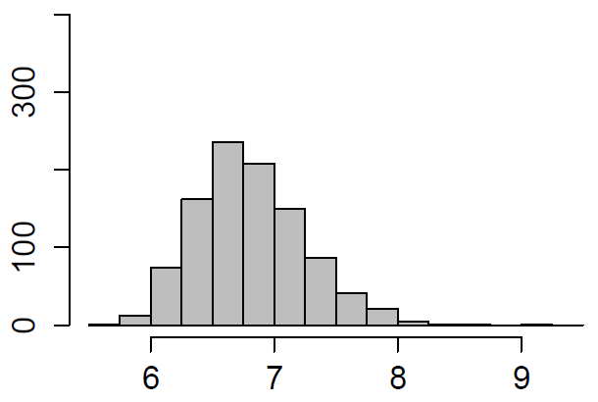
Simple bootstrapping results
ICES
Mean: 6.77
95% CI: 6.03–7.85
CJFAS
Mean: 7.05
95% CI: 6.60–7.49
Frequency
Mean citations per article

Slide 10
Bias-corrected and accelerated (BCA)
It turns out that simple bootstrapping (that we just did) can produce biased and skewed estimates of confidence intervals
State of the art is “bias-corrected and accelerated” confidence intervals
Corrects for situation where median different from mean (bias corrected), and where SD varies with mean (accelerated)
To implement it in R, we use the functions boot() and boot.ci() from package boot
Efron B (1987) Better bootstrap confidence intervals. Journal of the American Statistical Association 82:171-185

Slide 11
Implementing BCA bootstrapping
Create a function that will take the data and a vector of resampling indices, and return the statistic
func <- function(cites, ivec){
return(mean(cites[ivec]))
}
Call boot() and save the object
bootcorr <- boot(data=CJFAS$Citations,
statistic=func, R=5000)
Call boot.ci() with the saved object as a parameter
boot.ci(bootcorr, conf=0.95, type = "all")
Second argument: the boot() function will pass a vector of indices for one bootstrap sample
First argument, the data to be bootstrapped
"data" = first argument of func()
Calculates statistic for each bootstrap sample
Save bootstrap object
Number of bootstraps
Use bootstrap object
For 95% CI
Calculate CI in every possible way

Slide 12
> boot.ci(bootcorr, type = "all")
BOOTSTRAP CONFIDENCE INTERVAL CALCULATIONS
Based on 5000 bootstrap replicates
CALL :
boot.ci(boot.out = bootcorr, type = "all")
Intervals :
Level Normal Basic
95% ( 6.591, 7.509 ) ( 6.577, 7.498 )
Level Percentile BCa
95% ( 6.606, 7.528 ) ( 6.614, 7.534 )
Calculations and Intervals on Original Scale
Warning message:
In boot.ci(bootcorr, type = "all") :
bootstrap variances needed for studentized intervals
Plain percentiles of bootstrap distribution
The 95% CI for the bias-corrected and accelerated method
(A fifth method, the studentized method, requires additional variance calculations)

Slide 13
In-class exercise 1
Using the data in CJFAS.csv and ICES.csv, calculate the 90th, and 95th BCA confidence intervals for the trimmed mean of citations to articles in the two journals
The trimmed mean is obtained using mean(xvec, trim=p) to remove the highest fraction p and lowest fraction p of values before calculating the mean
For this exercise calculate the trimmed mean removing the highest 5% and the lowest 5% of values
Important: the number of repetitions R must be larger than the number of rows in your data
Which journal would you choose?

Slide 14
Is the “handedness” ratio biased in a class?
In a UW department there were 49 right-handed students and 52 left-handed students
In FISH123 there were 8 left-handed students and 3 right-handed students from this department
Are there significantly more left-handed students than expected by chance?
i.e. What is the summed probability of there randomly being 8, 9, 10, or 11 left-handed students in FISH 123, purely by chance?

Slide 15
Algorithm
Create a vector of 49 “R" and 52 “L" strings
Repeat a large number of times (niter)
Randomly sample 11 (without replacement)
If ≥ 8 are “L" then store TRUE, else store FALSE
At the end of the loop, count how many TRUE values were stored and divided by niter
This is the p-value!

Slide 16
p.hand <- function(niter, all.dept,
class.size, obs.lefties) {
num.left <- vector(length=niter)
for (i in 1:niter) {
X <- sample(x=all.dept, size=class.size,
replace=FALSE)
num.left[i] <- sum(X==“L")
}
p.value <- sum(num.left >= obs.lefties)/niter
return(p.value)
}
dept.grads <- c(rep(“R", 49), rep(“L", 52))
p.hand(niter=100000, all.dept=dept.grads,
class.size=11, obs.lefties=8)
Sample 11 grads, ≤ 1 time each
How many of the 11 are lefties “L"
Calculate how often more than 8 are left-handed
Divide by the number of resamples
All of dept grads

Slide 17
Answer
P-value for niter = 100, 10000, 1000000 were 0.15, 0.1187, 0.119727 respectively
True answer can be obtained from a hypergeometric distribution:
Sampling k=11 balls from an urn containing m=52 blue balls and n=49 red balls
How often do we pick 8, 9, 10, or 11 blue balls?
> sum(dhyper(x=8:11, m=52, n=49, k=11))
[1] 0.1197114 #not significant at 0.05
FISH123: p = 0.046 (10 of 13 lefties)
FISH124: p = 0.007 (15 of 19 lefties)

Slide 18
Should I choose ICES or CJFAS
The h-index (Hirsch 2005) is defined as “A scientist has index h if h of his or her N_{p} papers have ≥ h citations each and the other (N_{p} – h) papers have ≤ h citations”
Paper | Cites | Paper | Cites
1 | 25 | 8 | 4
2 | 13 | 9 | 3
3 | 7 | 10 | 3
4 | 6 | 11 | 3
5 | 6 | 12 | 2
6 | 5 | 13 | 2
7 | 5 | 14 | 2
Order papers from most to least cited. Check where paper number still ≥ cites, this is h.
Here h = 5.
Hirsch JE (2005) An index to quantify an individual’s scientific research output. PNAS 102:16569-16572

Slide 19
Journal h-index from 100 papers
For an individual, the more papers you publish that are well cited, the higher your h-index
For journals, those with more papers will have higher h values, so the ordinary calculation will favor larger journals, making it hard to compare journals
Instead, sample 100 papers and calculate h. Repeat over and over to obtain a distribution of h
This will be comparable across journals that publish different numbers of papers
Also, this allows us to test whether one journal is significantly better than another

Slide 20
In-class exercise 2 (part 1)
Create a function hindex() that calculates the h-index (this is our sample statistic!) for a vector of citations citation.vec
sort the citations from high to low using sort()
create a vector paper.vec from 1:n
h is the sum of paper.vec <= citation.vec
Testing:
> hindex(c(5,4,3,2,1,1,1,1))
[1] 3
> hindex(c(10,6,6,6,6,6,6,6,6,6,6))
[1] 6

Slide 21
In-class exercise 2 (part 2)
Now take the data in ICES.csv and CJFAS.csv
Create a vector CJFAS.better of size niter=1000
Repeat the following steps for i in 1:niter
Sample 100 values from CJFAS, calculate the h-index, store in X
Sample 100 values from ICES, calculate the h-index, store in Y
If X > Y then element i of CJFAS.better is set to TRUE, else it is set to FALSE
The p-value is the number of TRUE values in CJFAS.better divided by niter

